Slide 1
L2: Variables and conditionals and operators

Slide 2
Learning objectives
Secure
Identify examples of variables
Identify example conditionals
Identify example operators
Extend
Describe and construct a program appropriate variables, conditions and operators
Exceed
Evaluate effectiveness of the program

Slide 3
Open your ‘coding log’ doc file you created in lesson 1.
Create a new subtitle from where you added evidence from last lesson ‘Input, process and output’
Now open the instructions file and work through this to complete the mini game.
Once complete screenshot the code you have created and annotate it to describe what new coding skills you have picked up today.

Slide 4
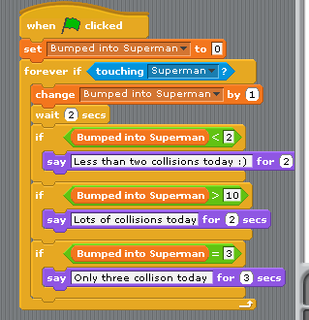
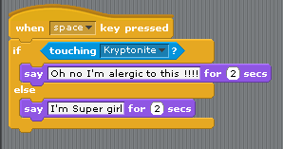
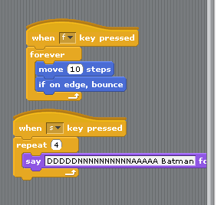
Code for player
Super girl code
Batgirl code
Super man code

